Slide 1
Uva 10342
Always Late
Time: 3 seconds

Slide 2
Problem Descriptions (1/2)
Ajmat Have you noticed one member of team 13 comes late in almost every contest?
Nejhum You mean the team of Mahbub, Moazzem and Yeamin? What’s the problem with them?
Ajmat All of them lives far away from BUET, and they always avoid the shortest path to BUET.
Nejhum Are you kidding? Why would they do so? A computer science student won’t ever do that.
Ajmat They always avoids the shortest path. They believe that they always face the worst traffic jam on their shortest way to BUET.

Slide 3
Problem Descriptions (2/3)
Nejhum That sounds crazy!
Ajmat They are more crazy than you think they are. They always try to use the path whose length is smaller than or equal to that of any path to BUET except the shortest one. And for that, they sometimes visit the same junction more than once.
Nejhum But they are not using the longest path. Then why are they late almost everyday?

Slide 4
Problem Descriptions (3/3)
Ajmat That’s because they have to spend a lot of time to find out which of the paths meet their criteria. Perhaps they don’t know how to find out the second-shortest path.
Nejhum I think we should solve this real problem in today’s contest, instead of solving imaginary ones.
Ajmat Let’s try.
Nejhum I think we should solve this real problem in today’s contest, instead of solving imaginary ones.
Ajmat Let’s try.

Slide 5
Input
The first line of each test case contains two integers: n (the number of junctions, 1 < n < 100) and r (the number of bi-directional roads connecting these junctions). The junctions are numbered with 0; 1; : : : n-1.
Each of the next r lines (one for each road) contains three integers:
two junction-numbers that the corresponding road connects and the length of the road in kilometers.

Slide 6
Input
The next line contains an integer q, the number of queries.
Each of the next q lines contains two junction-numbers.
There is a blank line after the q queries.
There is at most 1 road between each junction pair. A road always connects two different junctions.
Length of a road is not less than 1km and not more than 100km.
Input is terminated by EOF.

Slide 7
Output
For each set of output, print the set # (1, 2, …) followed by q lines, one for each query, each containing the length of the second-shortest path between the corresponding junctions.
However, for the unsolvable queries, print a ‘?’.

Slide 8
Example I/O
Number of nodes
4 3
0 1 12
0 2 20
1 2 15
3
0 1
0 2
0 3
4 3
0 1 11
0 2 20
1 2 15
3
0 1
0 2
0 3
Set #1
35
27
?
Set #2
33
26
?
Number of edges
Number of queries
(0, 2) 27
(0, 1) 35
12
0
1
20
15
2
3

Slide 9
Example I/O
4 3
0 1 12
0 2 20
1 2 15
3
0 1
0 2
0 3
4 3
0 1 11
0 2 20
1 2 15
3
0 1
0 2
0 3
Set #1
35
27
?
Set #2
33
26
?
Number of nodes
(0,1) 33
Number of edges
11
0
1
(0,2) 26
20
Number of queries
15
2
3

Slide 10

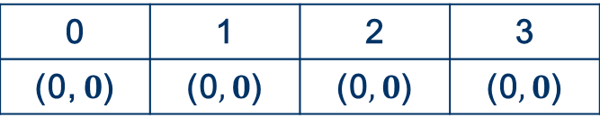


Second Shortest Path
0 | 1 | 2 | 3
(0, $0$) | (0$,0$) | (0$,0$) | (0$,0$)
s
11
0
1
20
15
2
3
(3, $∞$)
(2, $20$)
(1, $11$)

Slide 11



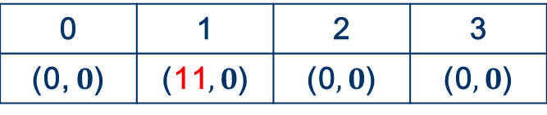


Second Shortest Path
0 | 1 | 2 | 3
(0, $0$) | (11$,0$) | (0$,0$) | (0$,0$)
s
11
0
1
20
15
2
3
(2, $26$)
(3, $∞$)
(0, $22$)
(2, $20$)
(3, $∞$)
(1, $11$)
(2, $20$)

Slide 12



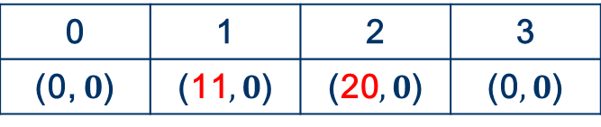






Second Shortest Path
0 | 1 | 2 | 3
(0, $0$) | (11$,0$) | (20$,0$) | (0$,0$)
s
11
0
1
20
15
2
3
(1, $35$)
(2, $26$)
(0, $40$)
(0, $22$)
(2, $26$)
(3, $∞$)
(0, $22$)
(2, $20$)
(3, $∞$)

Slide 13





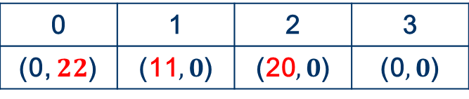






Second Shortest Path
0 | 1 | 2 | 3
(0, $22$) | (11$,0$) | (20$,0$) | (0$,0$)
s
11
0
1
20
15
2
3
(2, $42$)
(1, $35$)
(1, $33$)
(0, $40$)
(1, $35$)
(2, $26$)
(0, $40$)
(0, $22$)
(2, $26$)
(3, $∞$)
(3, $∞$)

Slide 14




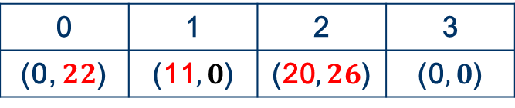








Second Shortest Path
0 | 1 | 2 | 3
(0, $22$) | (11$,0$) | (20$,26$) | (0$,0$)
s
11
0
1
20
15
2
3
(1, $41$)
(2, $42$)
(2, $46$)
(1, $33$)
(2, $42$)
(1, $35$)
(1, $33$)
(0, $40$)
(1, $35$)
(2, $26$)
(0, $40$)
(3, $∞$)
(3, $∞$)

Slide 15





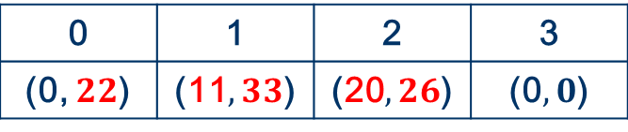








Second Shortest Path
0 | 1 | 2 | 3
(0, $22$) | (11$,33$) | (20$,26$) | (0$,0$)
s
11
0
1
20
15
2
3
(1, $41$)
(1, $41$)
(2, $46$)
(2, $46$)
(2, $42$)
(2, $42$)
(1, $33$)
(1, $35$)
(1, $35$)
(0, $40$)
(0, $40$)
(3, $∞$)
(3, $∞$)

Slide 16




Second Shortest Path
0 | 1 | 2 | 3
(0, $22$) | (11$,33$) | (20$,26$) | (0$,0$)
s
11
0
1
20
15
2
3
(1, $41$)
(2, $46$)
(2, $42$)
(1, $35$)
(0, $40$)
(3, $∞$)

Slide 17
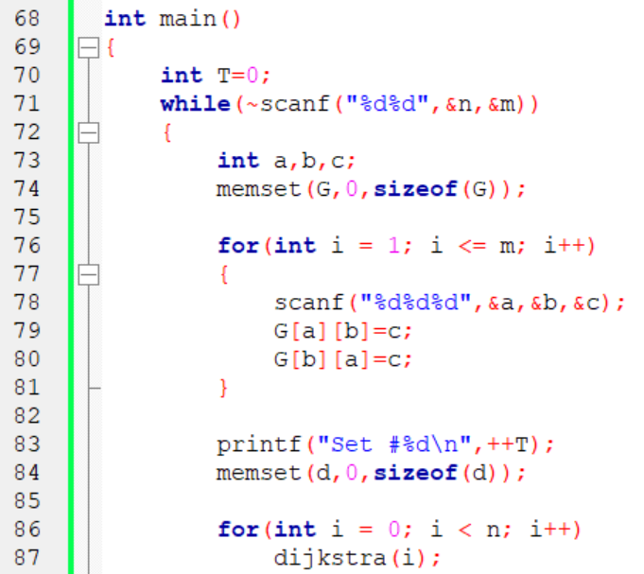

Slide 18
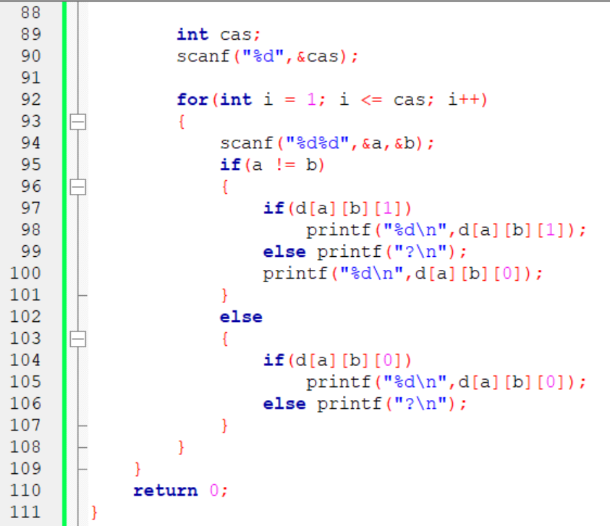

Slide 19
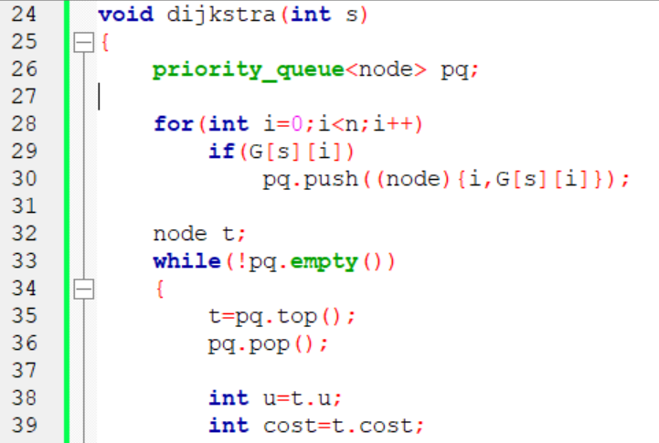

Slide 20
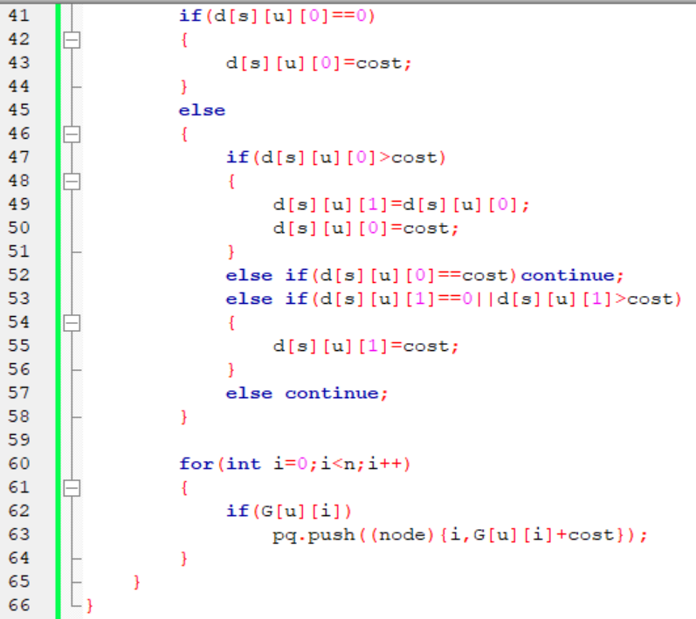

Slide 21
